Slide 1
A THIRD YEAR MINOR PROJECT ON HOME DÉCOR MARKETPLACE WITH RECOMMENDATION SYSTEM [CT 654] SUBMITTED TO: DEPARTMENT OF ELECTRONICS AND COMPUTER ENGINEERING
SUBMITTED BY:
AJAY MAHARJAN (HCE075BCT006) NIBENDRA BAJRACHARYA (HCE075BCT015) SUJAN MAHARJAN (HCE075BCT037) ASHISH RAI (HCE075BCT042)

Slide 2
INTRODUCTION
Buying and selling of goods and services
Improves the shopping experience dramatically
Saves a lot of time and provides convenient access from anywhere
To inform about the progress made so far
To evaluate the development of the project

Slide 3
OBJECTIVES
To show the amount of progress in the development of project so far as well as the work remaining for completion.
To update project tasks based on the progress made, and implement them in order to meet all the project goals.

Slide 4
REQUIREMENTS ANALYSIS
FUNCTIONAL REQUIREMENTS
Login and Register
Browse products
View description of products
Add/Remove from cart
Payment options
Recommend products
Notification
Chat system

Slide 5
NON FUNCTIONAL REQUIREMENTS
Reliability
Availability
Performance
Scalability
Maintainability
Security
Usability

Slide 6
FEASIBILITY STUDY
Technical Feasibility - Hardware and software tools are easily available
Operational Feasibility - Simple and interactive interface
Economic Feasibility - Only a computer is required to access the web application

Slide 7
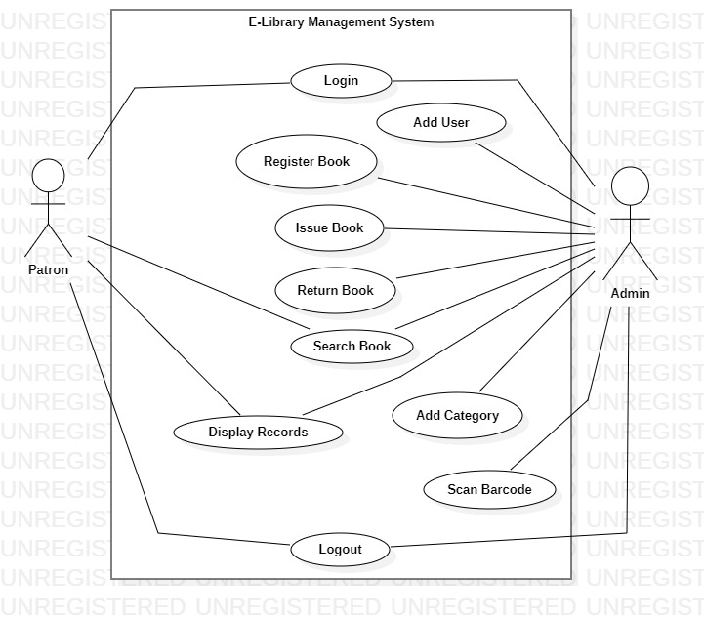
SYSTEM DESIGN
USE CASE DIAGRAM

Slide 8
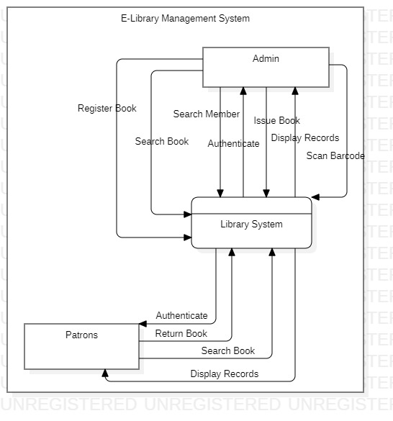
DATA FLOW DIAGRAM – LEVEL 0

Slide 9
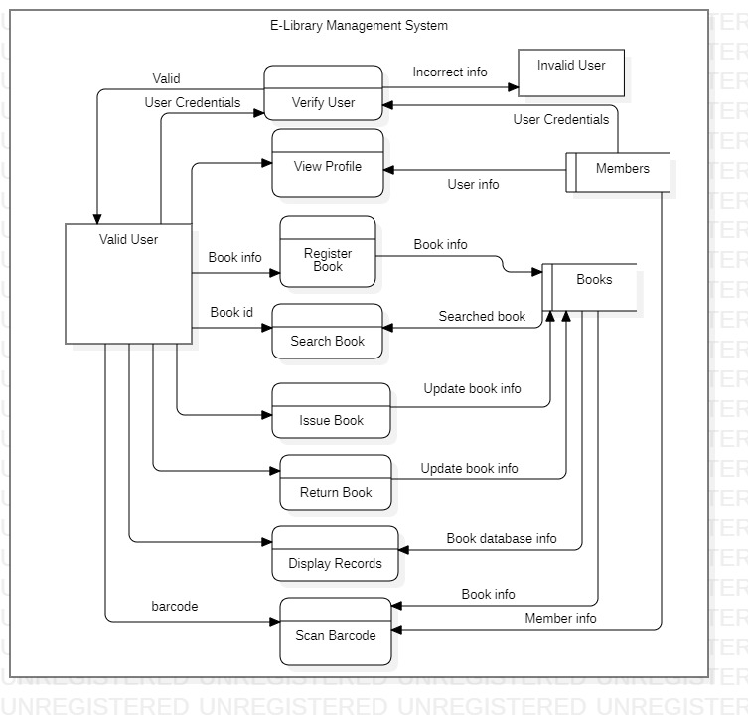
DATA FLOW DIAGRAM – LEVEL 1

Slide 10
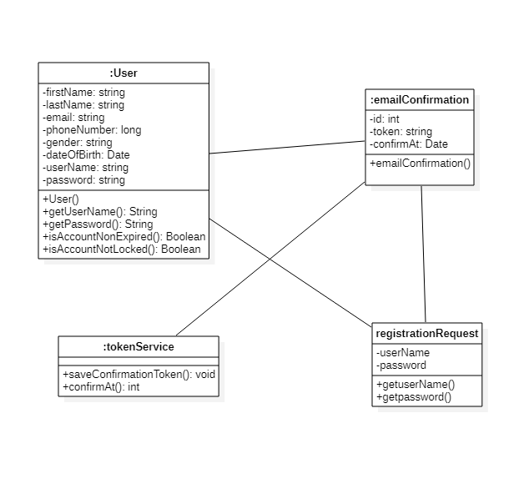
CLASS DIAGRAM

Slide 11
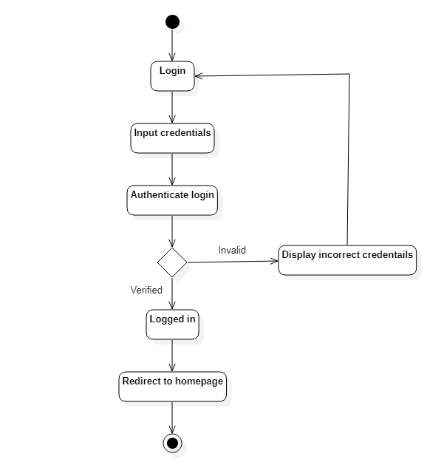
ACTIVITY DIAGRAM FOR LOGIN

Slide 12
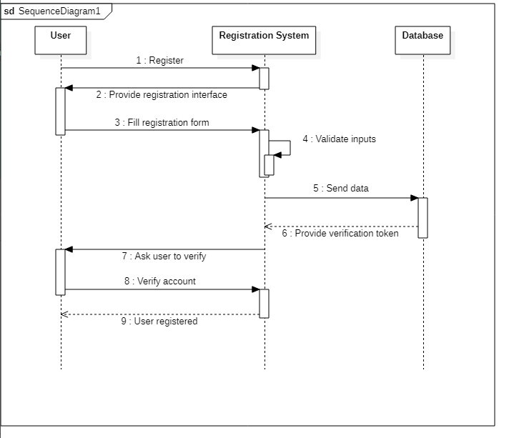
SEQUENCE DIAGRAM FOR LOGIN

Slide 13
SEQUENCE DIAGRAM FOR REGISTER

Slide 14
METHODOLOGY
PROJECT TOOLS USED:
HTML
form the building blocks of all websites
provides a means to create structured documents.
can embed scripts written in languages.

Slide 15
CSS
formatting of a document written in a markup language
allow the same markup page to be presented in different styles

Slide 16
JavaScript – React
declarative, efficient, and flexible JavaScript library for building reusable UI components
an open-source, component-based front end library.
Components can be nested with other components.
uses virtual DOM based mechanism to fill data in HTML DOM.
The virtual DOM works fast.
Allow to divide entire application into components.
JSX is the react extension.

Slide 17
Java Spring
It’s a java platform that provides comprehensive infrastructure support for developing Java applications.
execute in a database transaction without having to deal with transaction APIs.
a remote procedure without having to deal with remote APIs.
a management operation without having to deal with JMX APIs.
a message handler without having to deal with JMS APIs.

Slide 18
PostgreSQL
open-source object relational database management system
PostgreSQL uses and extends SQL
it’s a store of relations between tuples representing entities and relationship.
supports transactions with ACID properties
serve as event cache between applications and event consumers

Slide 19
REFERENCES
[1] "Online shopping: The pensioner who pioneered a home shopping revolution". BBC News. 16 September 2013. Archived from the original on 17 July 2018. Retrieved 21 June 2018.
[2] "Dealing with other businesses online". Australian Competition & Consumer Commission. Government of Australia. Archived from the original on 19 January 2013. Retrieved 4 May 2021.
[3] Khurana, Ajeet (25 November 2019). "Did You Know That There Are 4 Types of Ecommerce?". The Balance Small Business. Dotdash. Archived from the original on 22 January 2021. Retrieved 4 May 2021.
[4] Millward, Steven (18 August 2016). "Asia's ecommerce spending to hit record $1 trillion this year – but most of that is China". Tech in Asia. Archived from the original on 19 August 2016. Retrieved 4 May 2021.
[5] "Electronic money and electronic commerce". BBC News. Archived from the original on 4 May 2021. Retrieved 4 May 2021.

Slide 20
THANK YOU

